Slide 1
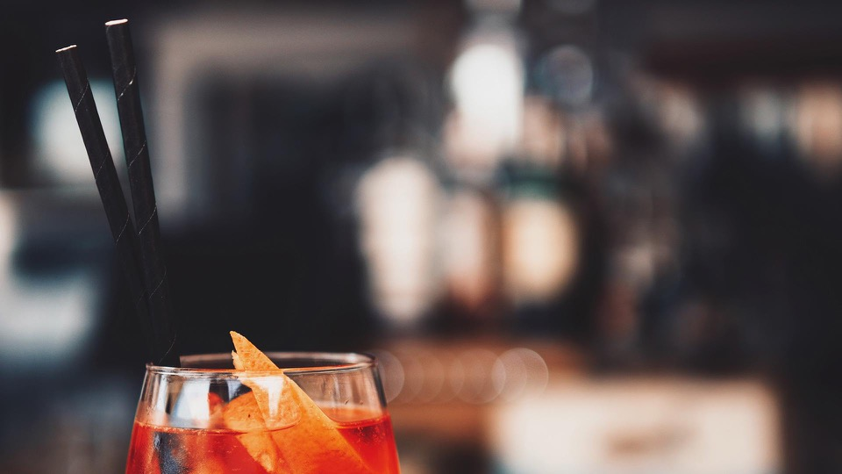
Bôkan Restaurant Rebranding Data Science Consulting Project
X-HEC x Capgemini Invent
Group 6

Slide 2
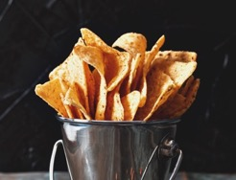
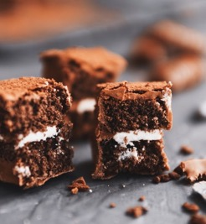
OUTLINING YOUR GOAL
→ Rebrand the restaurant
Innovation in the choice of cuisines and the menu
Space rebranding based on analysis of data collected
→ Increase profit margin
Breakeven Estimation
Expansion of Client base
Securing higher performance

Slide 3
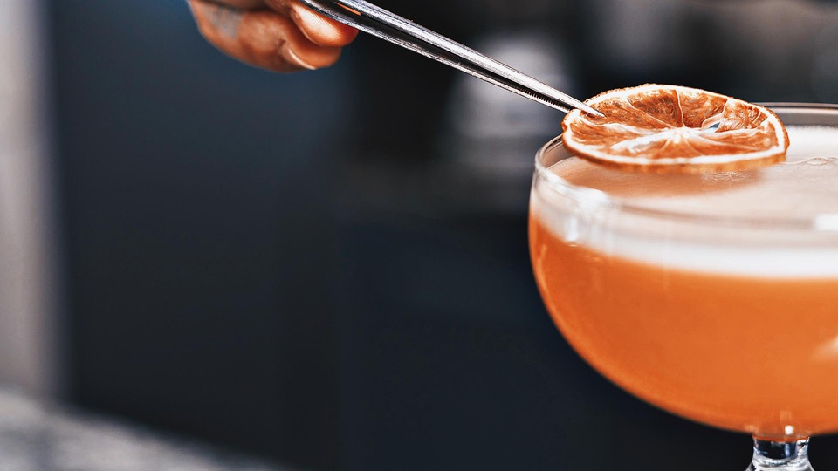




TEAM
TOMMY TRAN
ISMAIL MAJJAD
THOMAS DE MAREUIL
BADR EL-IDRISSI MOKDAD
AKHILA VANGARA

Slide 4
PROJECT TIMELINE
FEBRUARY
MARCH
Intermediate results
Final presentation
Overall project
Efficient
rebranding
Problem definition
recommendations
AI analysis
Based on
Cost & revenue estimation
NLP
analysis
Recommendations

Slide 5
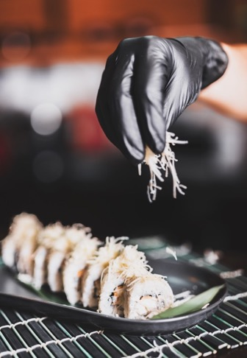
01
REGULAR BUSINESS APPROACH TO YOUR PROBLEM
02
OUR ADDED-VALUE : TECHNICAL ANALYSIS
03
OUR RECOMMENDATIONS
AGENDA
04
AFTER THE REBRANDING

Slide 6
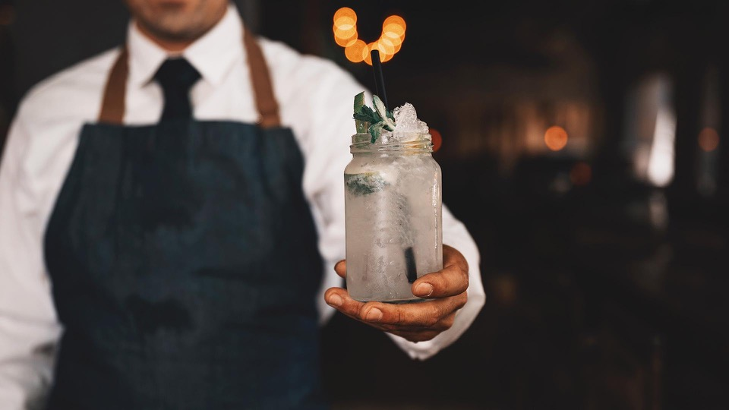
01
REGULAR BUSINESS APPROACH
Market research findings
COGS analysis

Slide 7
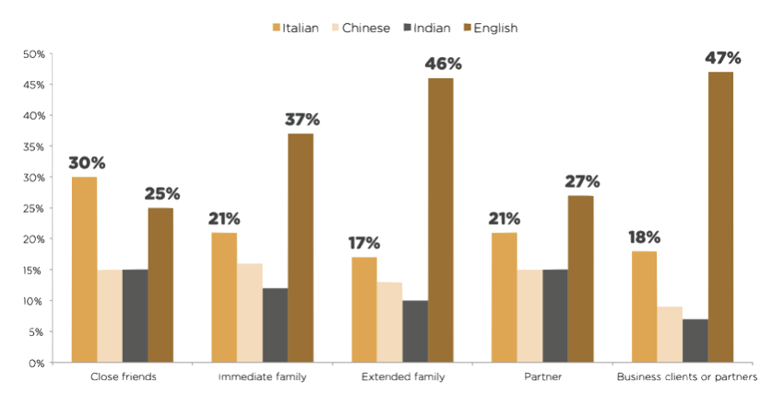
MARKET TRENDS IN LONDON RESTAURANTS

Slide 8
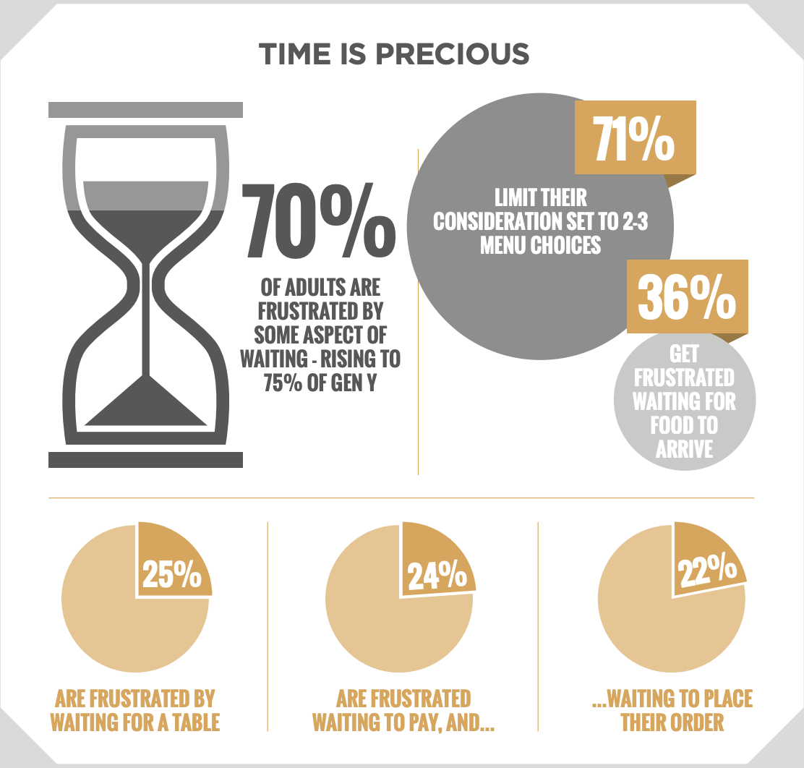
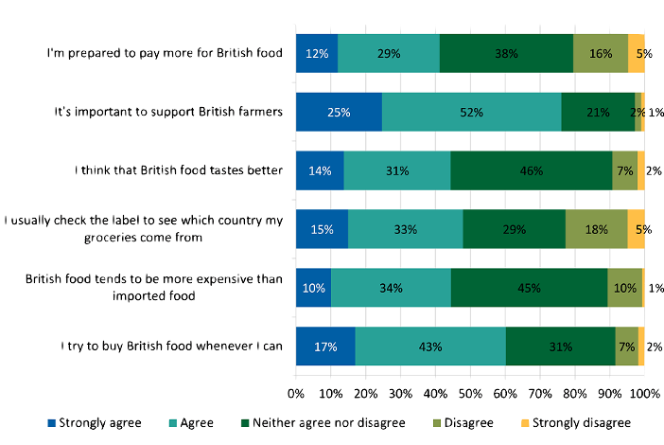
MARKET RESEARCH FINDINGS – MARKET TRENDS

Slide 9




MARKET RESEARCH FINDINGS – COMPETITION
Canary Wharf trends:
Corporate dining, after work
Thousands of corporate people working in and around the area daily
Prime restaurants in the heart of the area is Roka, serving Japanese-style dishes in a modern setting. Or for a taste of South America, Guacho gives diners a taste of the best beef and wine Argentina has to offer.
Local restaurants can source some of the finest catches from the market.

Slide 10
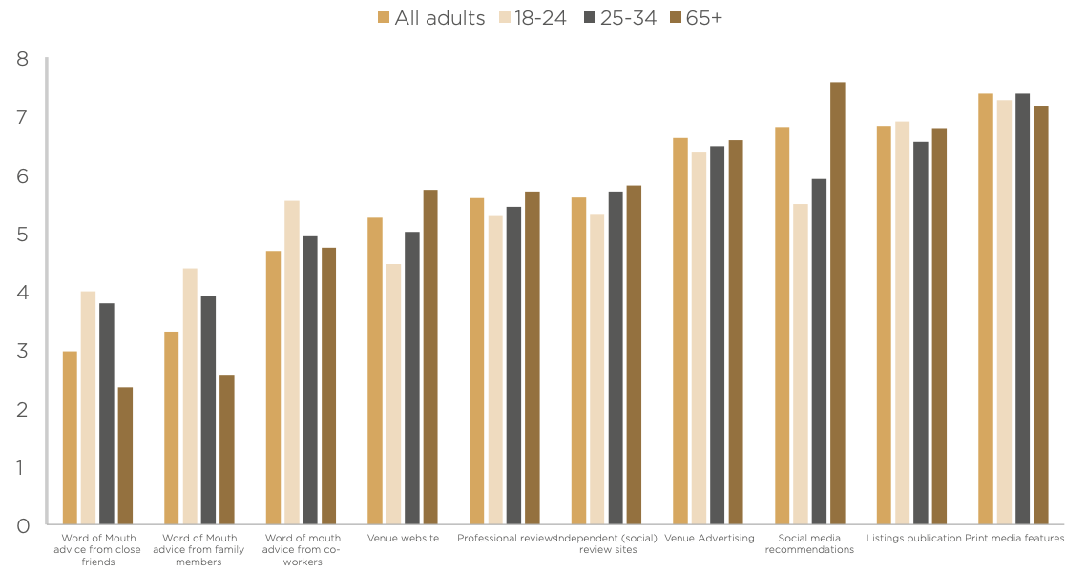


MARKETING STRATEGY
Communications channels Yecision-making
Social media
Bokan: 18K likes
Bokan: 12.2K followers
Roka: 9K likes
Roka: 43.2K followers
Gaucho: 12K likes
Gaucho : 26K followers

Slide 11
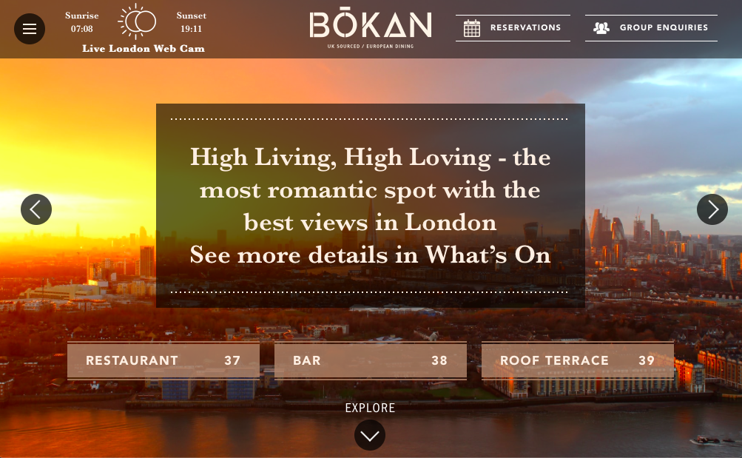
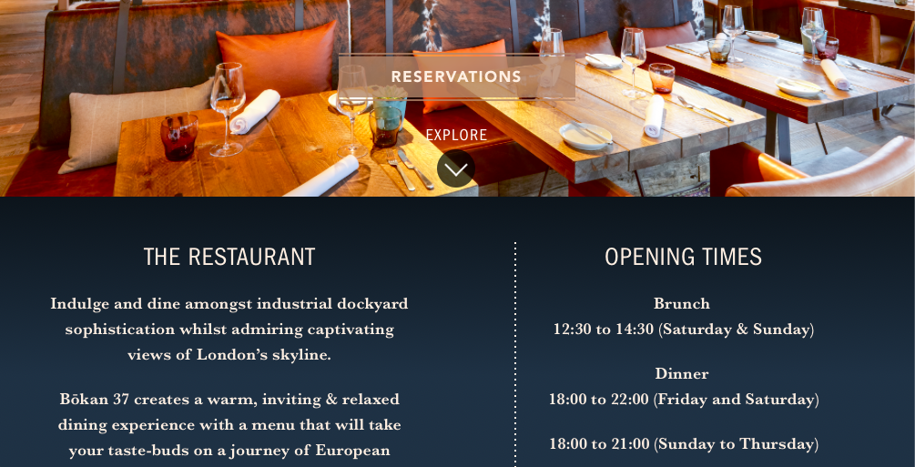
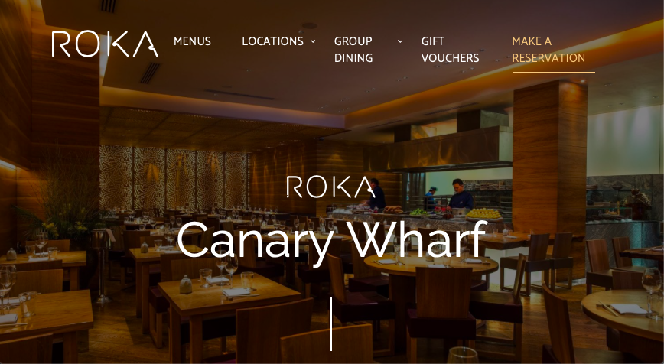
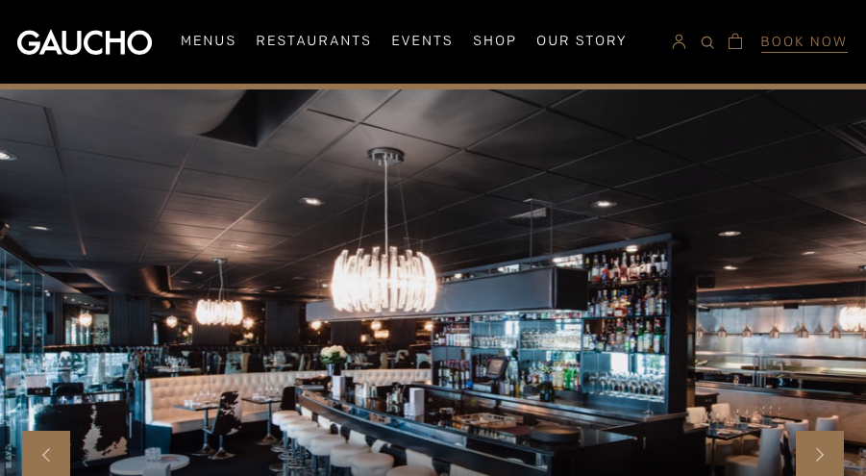

ONLINE USER EXPERIENCE
We analysed Bokan’s website, with 2 important concepts in mind:
The 15 second rule: when looking for information, customers usually don’t spend more than 15 seconds on your website
Bounce rate: refers to users going backwards when they did not find relevant information

Slide 12
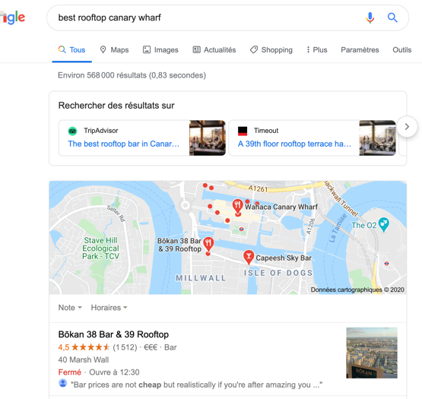
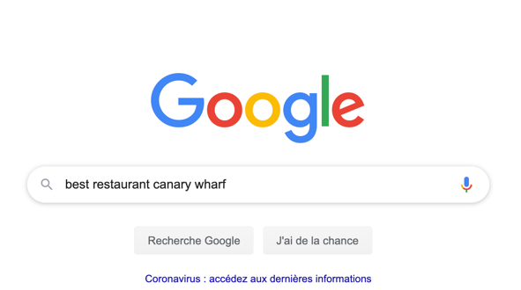
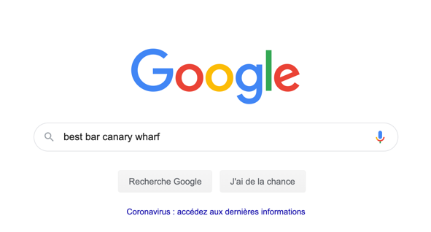
SEARCH ENGINE APPEARANCE
Bokan as Best rooftop
Bokan 37: 3 times on first page
Roka: 8 times on first page
Bokan 38: 5 times on first page
Roka: 5 times on first page

Slide 13
Cost of Goods Sold (COGS)
Cost of Goods Sold (COGS) refers to the cost required to create each of the food and beverage items you sell to guests. In this way, COGS is really just a representation of your restaurant’s inventory during a specific time period. In order to calculate COGS, you need to record inventory levels at the beginning and end of a given period of time, along with any additional inventory purchases.
It’s important to track COGS because it’s typically one of the largest expenses for restaurants. By identifying ways to minimize these costs — like negotiating better rates with your food distributor or selecting in-season ingredients — it's possible to significantly increase margins. Every dollar you shave off COGS is another dollar added to the restaurant’s gross profit.
How to Calculate COGS
The equation for COGS is:
Beginning Inventory + Purchased Inventory - Final Inventory = Cost of Goods Sold (COGS)

Slide 14
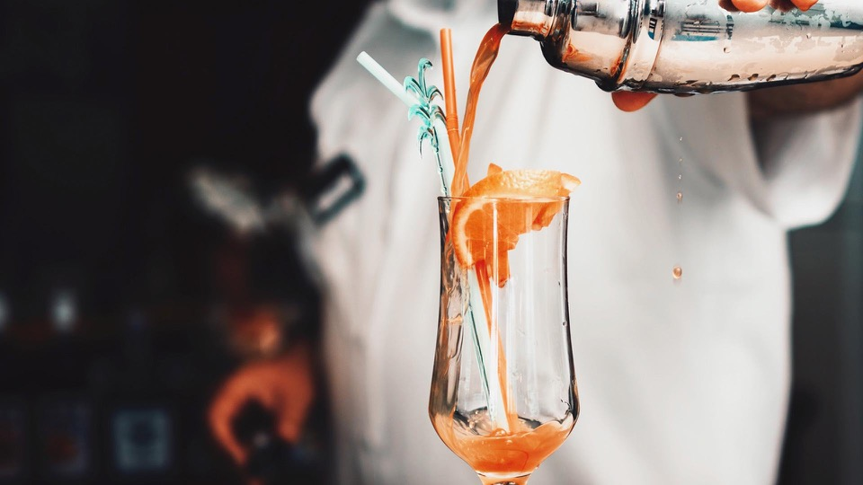

02
OUR ADDED-VALUE : TECHNICAL ANALYSIS
Web scrapping
Review embeddings
Topic extraction

Slide 15
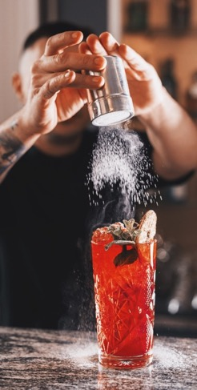
OUR ADDED- VALUE: NATURAL LANGUAGE PROCESSING (NLP) TO COMPLEMENT BUSINESS FINDINGS
To bring value on top of the regular business approach, we conducted an AI-based technical analysis, using reviews from Tripadvisor.com for restaurants in London.
We built a NLP model to understand what makes restaurants successful (or not!) in London, and provide more accurate recommandations for Bokan’s rebranding.
Our technical analysis went through the following steps:
01
02
03
Collect and clean Data
Build a Word Embedding model to prepare analysis
Conduct Topic Extraction to help build recommendations

Slide 16
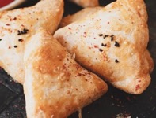
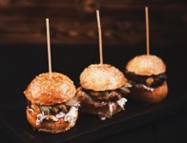
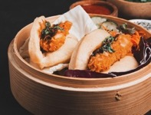
DATA COLLECTION & DATA CLEANING
STEP
01
Web Scrapping
Tokenization
Lemmatization
Collect as many reviews on the Internet as possible (several thousands)
Break a stream of text into words, phrases, or other meaningful elements called tokens
Reduce inflection in words to their root forms ensuring that the root word belongs to the language

Slide 17
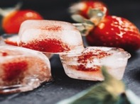
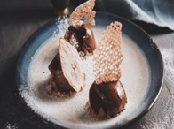
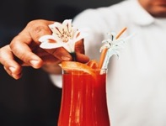
WORD EMBEDDING
STEP
02
Embedding
LSI
Word2Vec
Representation in which a word is associated to a numeric vector. We can then perform calculations and operations on embedding matrices
Mathematical method for modeling the meaning of words and passages by analysing a corpus of texts
Embedding method which embark a neural net with context and target word notions

Slide 18
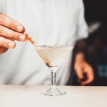
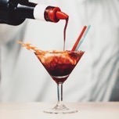
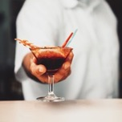
TOPIC EXTRACTION
Topic Extraction to find the words most relevant to 5 star and 1 star ratings
STEP
03
LDA
GSDMM
xx
‘Latent Dirichlet Allocation’ is a generative probabilistic model.
The topic model estimated by LDA consists of two matrices –
Probability of selecting a part(word) when sampling a topic
Probability of selecting a topic when sampling a document
Used Ldamodel() provided by gensim
Found 10 most relevant topics and words associated with them
pyLDAvis to help interpret the topics in a topic model that has been fit to a corpus of text data.
Extracts information from a fitted LDA topic model to form a visualization.
‘Gibbs Sampling Algorithm’ for Dirichlet mixture model
Useful for text clustering
Used MovieGroupProcess() by genism
pyLDAvis interpretation in place for GSDMM as well.
xx

Slide 19
LDA Topics :
main course meals – Chicken, fish & chips, burgers, steak, sauces and meat
Service details – feedback on services, food and events, recommendations
Italian food – pizza, pasta and wine
Meat based dishes – Lamb, sushi, chicken etc
Location details – street, venue, London, restaurant etc
Smaller meals – tea, breakfast, eggs, sandwich
Details of the bar – pub, drinking, live music, garden, atmosphere, Sunday
Service details – wait time and order time

Slide 20
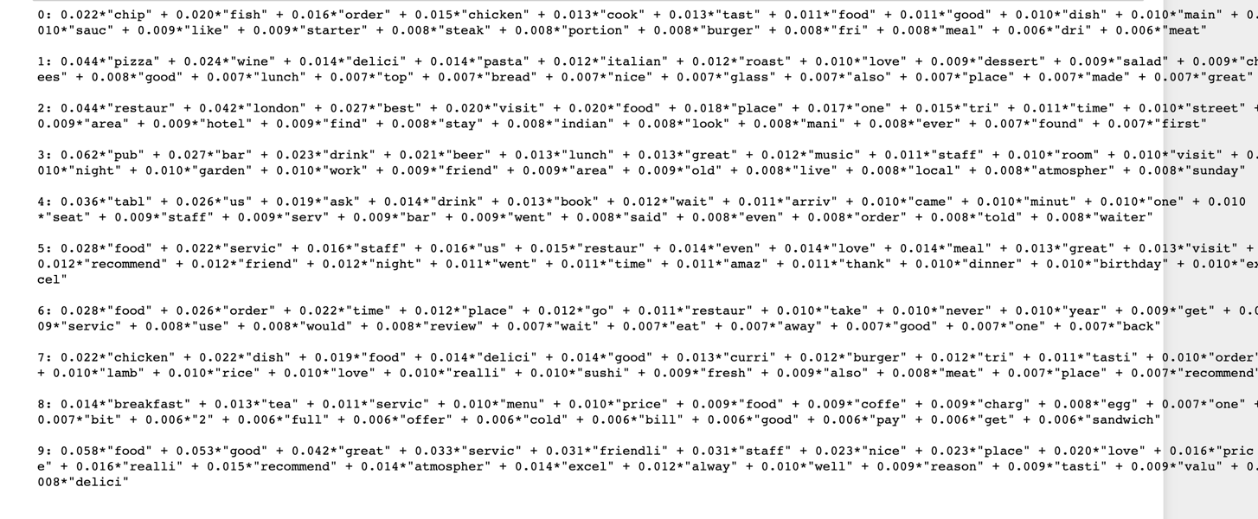
LDA Topic Extraction
Each topic has distinct words associated. These words are captured along with their associated probabilities in a given topic

Slide 21
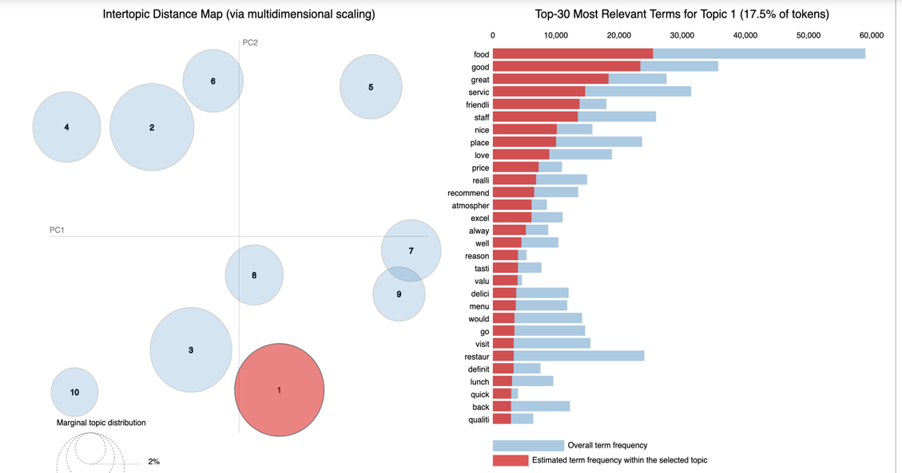
InterTopic Distance
The intertopic distance was plotted to ensure that the topics extracted are in fact independent from each other
pyLDAvis was used to generate these graphs
The topics are plotted against Principal Components – breaking down the data in topics aids in dimension reduction analysis
Most relevant terms per topic and overall were studied to engineer recommendations

Slide 22
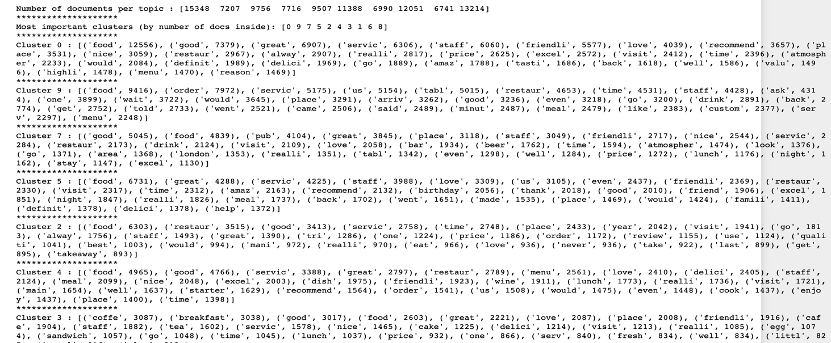
GSDMM
Text clusters created as per relevant topic in GSDMM, using the MovieGroupProcess() technique
Dimension reduction – documents seggregated by topics and clusters ranked in importance by number of documents in each topic cluster

Slide 23
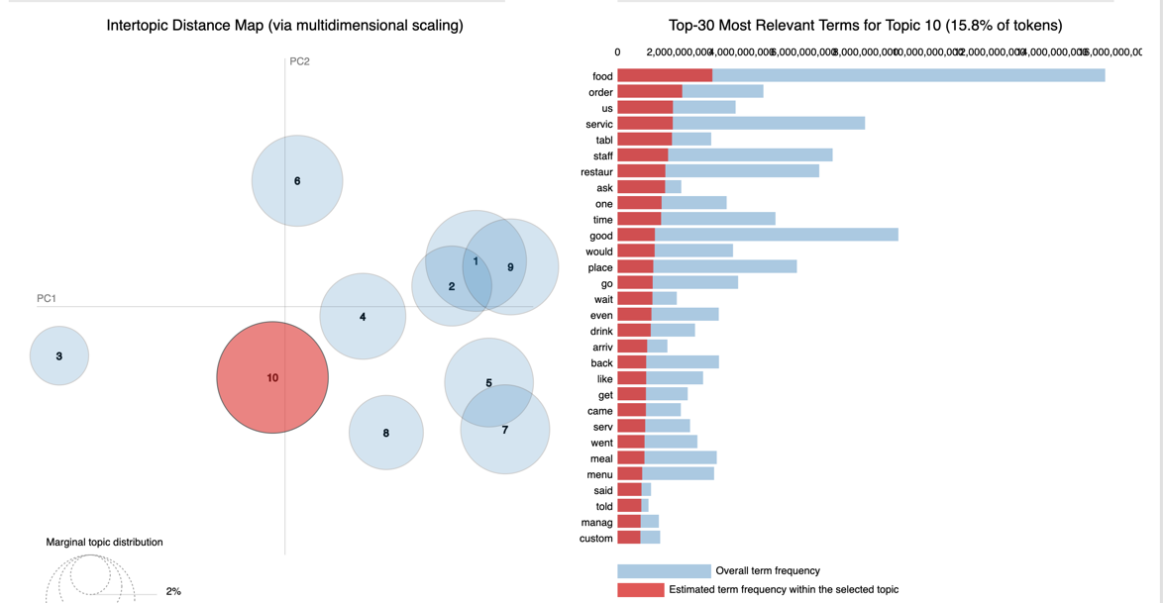
Intertopic Distance (GSDMM)
Interdistance map not as well spread out as that for LDA model.
These represent the most important words in each cluster and their frequency of occurrence

Slide 24
WORDPLOTS
Most frequently occuring words for 1 star ratings are in the word plot.
Feedbacks on food, staff(service), order time, order issues are the most prevelant

Slide 25

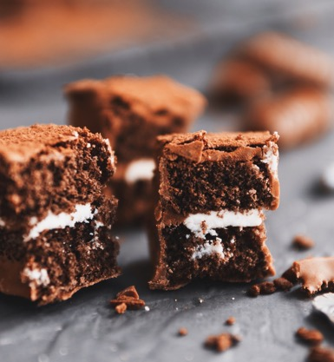

SENTIMENT ANALYSIS
STEP
03 bis
Flair
Vader
xx
Introduced in 2014, VADER sentiment analysis uses a human-centric approach, combining qualitative analysis and empirical validation by using human raters and the wisdom of the crowd.
Flair is a simple natural language processing (NLP) library developed and open-sourced by Zalando Research.
Flair’s framework builds directly on PyTorch, one of the best deep learning frameworks out there.
VADER (Valence Aware Dictionary for sEntiment Reasoning) is a model used for sentiment analysis that is sensitive to both polarity (positive/negative) and intensity (strength) of emotion.

Slide 26
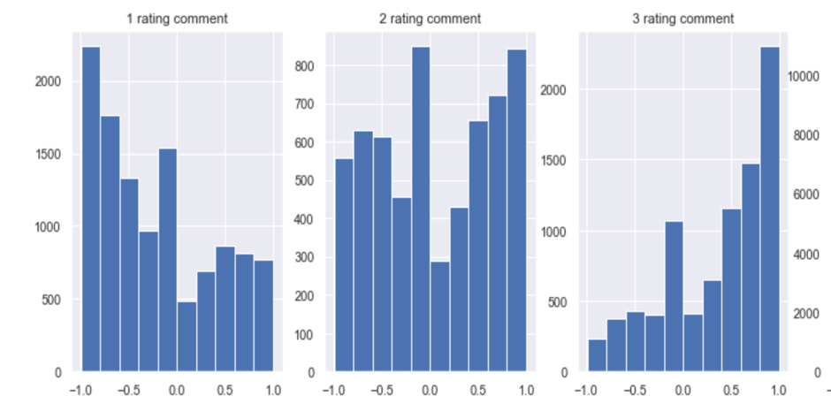

01
02
PROJECT TIMELINE
01
02
Here you could describe the topic of the section
Here you could describe the topic of the section
The Vader sentiment analysis shows that some comments, though with a positive sentiment, correspond to a low rating comment
This inconsistency reduces as we go towards the higher ratings. The number of negative sentiment comments are much lesser than the positive sentiment ones for a 3 star rating.

Slide 27
03
OUR RECOMMENDATIONS
Rebranding & prototype
Other strategic advice

Slide 28
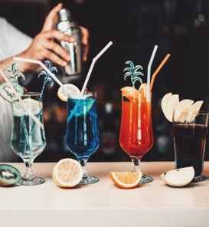
OUR RECOMMENDATIONS AT A GLANCE
Rebrand the restaurant as high-end pub cuisine
xxx
xxx
New marketing strategy
Details
Keep the name for coherence / existing customers
Etc.
xxx
This slide should be a summary of our main recommendations
With quick cost estimation
xxx

Slide 29
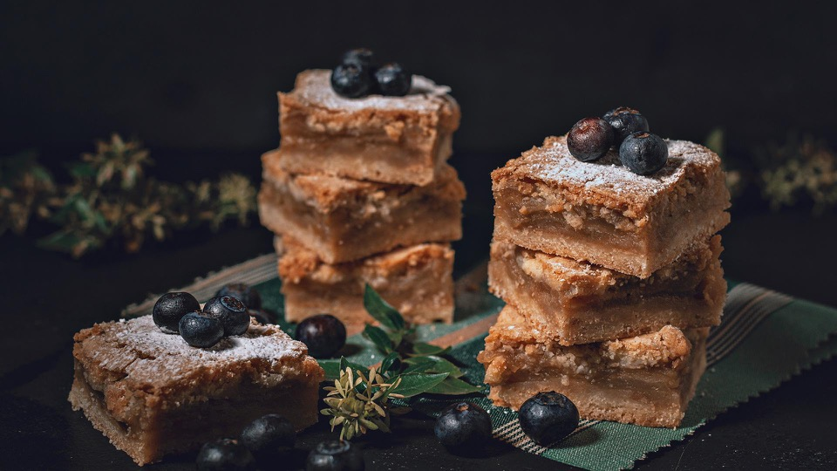
+20%
OUR GOAL
This slide should be used to put forward the most striking thing in our recommendations
(slide content to be re-written accordingly)
in profits, at a 2-year horizon

Slide 30
Reco 1
Each recommendation in our overview (cf. first slide in this section) should now have its own slide with details
No matter the companion, preferences go toward English (1st) and Italian (2nd)
Increasing concern about the food being local
Most important thinks: Good value for Money and novelty
Most important communicatio channels: Printed media features, direct advertising and social medias
Appeal toward novelty
Service has to be fast (oder, service and pay)
Consumer limit their choices to a few items

Slide 31
Reco 2

Slide 32
Reco 3

Slide 33
Reco 4

Slide 34
New menu prototype
One slide in this section should also be our new menu prototype

Slide 35

04
AFTER THE REBRANDING
Breakeven estimation
Key KPIs to monitor

Slide 36
Breakeven estimation
Slide still to be written
(estimation of rebranding costs + moment when rebranding costs will be absorbed)

Slide 37

Key Performance Indicators (I)
Sales
Break Even point – Sales volume needed to earn back the amount invested
Gross Profit – Restaurant earnings after subtracting the cost of goods sold
Cash Flow – Total cash that goes in vs what flows out (Cash Input - Cash Output)
Social Media
Engagement – Number of likes, shares, retweets or comments for each post
Reach – Social media audience: number of followers, traffic data, etc.
Slide (1) to be re-written (shorter) and re-designed to present the key KPIs to monitor after the end of the project (for when the restaurant owners will be on their own)
Customer Feedback
Customer Reviews – reviews on Facebook, TripAdvisor, booking.com, etc.
Overall Customer Satisfaction (CSAT) – CSAT scores are based on surveys where customers rate satisfaction from 1 to 7 (positive responses start at 5).
Time per table turn and table turnover rate (TTR: Nb of Guests Served / Nb of Tables) - to provide adequate wait times (impacting CSAT) and maximize revenue.
Customer Retention Rate (%) = (# of Customers at End of Period - # of Customers for That Period) / (# of Customers at Beginning of Period). A 5% increase in customer retention can lead to up to 90% increase in profits (Harvard, 2012).

Slide 38
Key Performance Indicators (II)
Employee Engagement KPIs
Employee Turnover – Hiring and training new employees is costly, thus it’s important to define an “acceptable” level of turnover (taking into account the high average turnover rates in London). Employee retention can be improved by valuing employee feedback and dialogue.
Employee Satisfaction (ESAT) – Score measured through team meetings and surveys. Companies with high ESAT rate tend to outperform competitors.
Sales per labour hour (SPLH: Total sales / total # of worked hours) – SPLH is a measure of employee performance, with target sales per hour scheduled.
Slide (2) to be re-written (shorter) and re-designed to present the key KPIs to monitor after the end of the project (for when the restaurant owners will be on their own)
Kitchen and front house management
Revenue per available seat hour (RevPash = Total revenue / [available seats x opening hours]). RevPASH is used to optimize labor scheduling, plan food purchasing, and to improve table turn times.
Food and beverage sales per guest – Allows to understand if menu needs to be restructured based on favorites of the customers or time of the day.
Menu Item profit and popularity – Such measures allow for strategic pricing of items on the menu, to drive sales and make decisions for promotions / discounts.

Slide 39
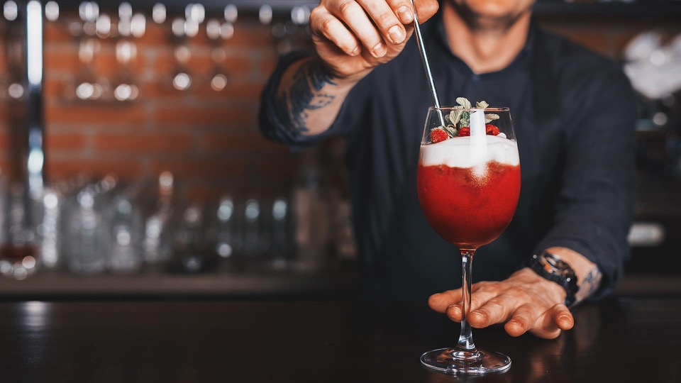
MANY THANKS FOR YOUR ATTENTION

Slide 40
xx
The next slides are the contents from our previous presentation. I put them there so we can have them under our hand if we want to insert some elements in our new presentation.

Slide 41
BOKAN : A STRATEGIC ANALYSIS (SWOT)
Bar & Restaurant & Rooftop
Above the Novotel HOTEL in Canary WhARF
Weekly events including themed music performances
Bokan is a well-established bar & restaurant that needs to prospect for new types of customers

Slide 42

Strengths
Flexible: As the restaurant was not created toward a certain type of food, the chef is free to change the menus regularly, allowing the restaurant to adapt to current trends an attract more clients
Brand positioning: Award-winning for food & drink. Experienced and renowned French chef Guillaume Gillan in charge of the kitchen.
Location and view: Canary Wharf is the main business district of London, resulting in thousands of potential clients year-round. The restaurant attracts many customers for its breathtaking view.
Well-known and well-placed

Slide 43
Client base: Targets mostly business and hi-budget clients
Access means: The restaurant and the bar are hard to find and access since they are located on the 37th and 38th floor of a hotel.
Weaknesses
A too selective client base

Slide 44
Location: location in Canary Wharf targets business clients, which make for a regular and more predictable client base (business dinners, etc).
Pricing power: business clients tend to be less sensitive to prices (banks, etc.). Location (next to offices) and quality tend to be more important than prices.
Opportunities
Luxury catering is doing well

Slide 45
Threats
Competition from new business: Growing trend over new types of restaurant such as fancy fast-foods and Vegan restaurants.
Competition from existing business: Companies might want to keep it simple and stick with the long-established brands in Canary Wharf when planning business trips.
Slowdown in activity with Brexit: banks moving offices to France or other EU countries might impact hospitality and restauration industries in Canary Wharf.
Increased competition & impact of Brexit

Slide 46




REVENUE ESTIMATION : RESTAURANT
01 BRUNCH
02 DINNER
70 seats 2 services
70 seats 2 services
50% Occupancy rate
80% Occupancy rate
100% Fri/Sat 80% Sun 70% Other
70 people eating
110 people eating
Menu of £52
£45 per person
Menu of £52
£20 per person
£52 per person
£65 per person
£3.700 per brunch
£7.200 per dinner

Slide 47
REVENUE ESTIMATION : BAR/ROOFTOP IN WINTER
01 12h – 15h
02 15h – 19h
01 19h – 00h
50 seats
50 seats
50 seats
20% Occupancy rate
40% Occupancy rate
60% Occupancy rate
£20 per person
£20 per person
£10 per person
£20 per person
£30 per person
£40 per person
£400 per hour
£1.000 per hour
£1.800 per hour
£14.300 per day in winter

Slide 48
REVENUE ESTIMATION : BAR/ROOFTOP IN SUMMER
01 12h – 15h
02 15h – 19h
01 19h – 00h
50 seats
50 seats
50 seats
50% Occupancy rate
80% Occupancy rate
90% Occupancy rate
£20 per person
£20 per person
£10 per person
£20 per person
£30 per person
£40 per person
£1000 per hour
£2000 per hour
£2150 per hour
£21.800 per day in summer

Slide 49
REVENUE ESTIMATION
Restaurant / Brunch
Restaurant / Dinner
Bar & Rooftop / Winter
Bar & Rooftop / Summer
£3.700 per lunch
365 days
1.4 M£ per Year
£7.200 per dinner
365 days
2.6 M£ per Year
£14.300 per lunch
8 months
3.5 M£ per Year
£21.800 per lunch
4 months
2.6 M£ per Year
Total Revenues: 10.1 M£ per Year

Slide 50

10.1 M£
40%
22 K£
REVENUE ESTIMATION: KEY TAKEAWAYS
Earnings per year
Part of the restaurant in the total earnings
Earnings per day in summer for the bar

Slide 51


WHERE WE ARE
WHERE WE WANT TO BE
Our current estimates:
Sales: 10.1 £M
OR: between 20% and 80% depending on hour
Conservative average spending estimate
Costs still to be optimized
Quick and efficient transformation measures to boost profits:
Sales: ≈ 12 M£ (+19%), through revenue optimization measures and +10ppt OR on average
Costs: increased marketing spending but overall optimization, to reach +20% profits at a 2-year horizon

Slide 52

Market Research: London (draft)
What kind of restaurant do people go to ? By user category, by period
Average spending by user category
What food do people go to ? By user category
How long do people spend at a restaurant ? By user category
Menu and pictures of most successful restaurants
Actual trend: bio, local food, vegan
Adapt according to the season
Best quality-price
Gaucho and Roka set toward a specific type of food. Unclear for Bokan

Slide 53
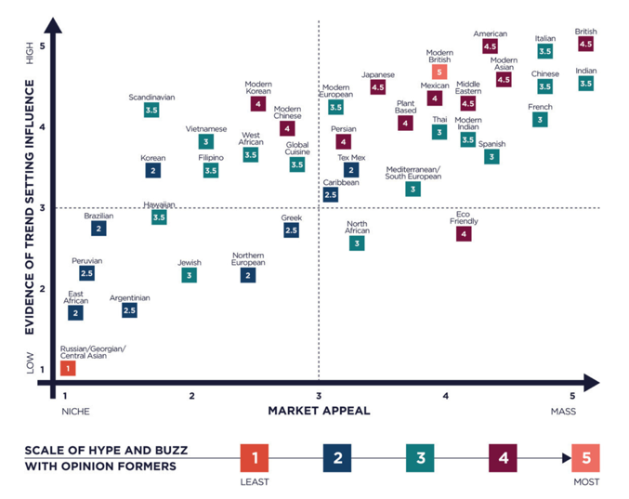
APPENDIX

